Slide 1
Open Microsoft
Andre Rodrigues
Senior Software Development Engineer
Email: andrerod@microsoft.com
Twitter: @andremrodrigues
Notes:
Hello everyone.
So let’s get this started… my name is Andre Rodrigues and Im a Software Development Engineer at Microsoft.
I’m here today to talk about open source and, in particular, how it relates to cloud computing.

Slide 2

Notes:
As you may have noticed from the name, I am portuguese.
Which means, given the audience we have here today, I should mention it’s the best team in southwest europe, right ? ☺
Kidding ☺

Slide 3
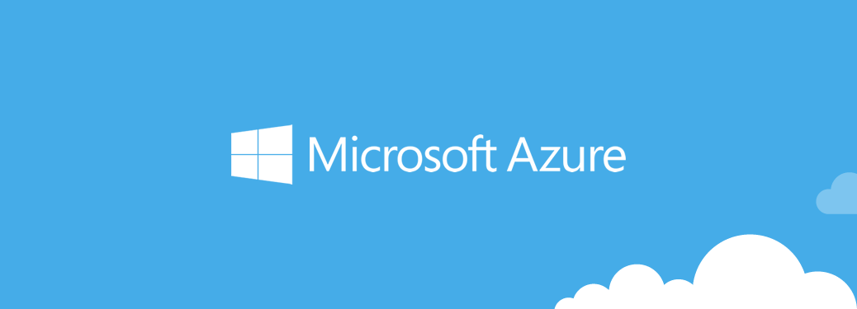
Notes:
Ok, so in this presentation I would like to start talking about the product I work for and then explain how I think it greatly relates to openess and some of the new things microsoft is doing.
Who has heard of cloud computing ? What about microsoft azure ?

Slide 4
Everything starts with a Problem
Notes:
Ok… so for the very few of you, that may have some doubts about what is cloud computing and which problems it aims to solve, let’s do a quick introduction.
So it is said that everything starts with a problem.

Slide 5
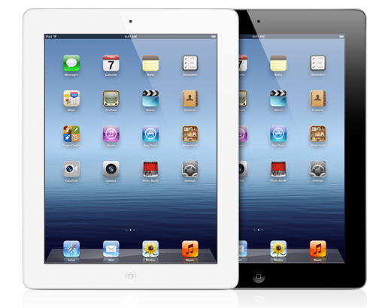
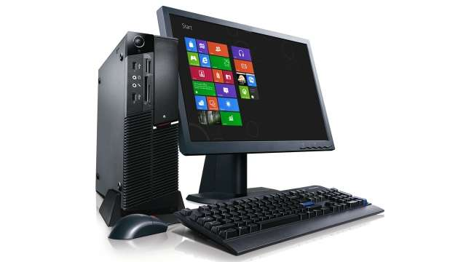
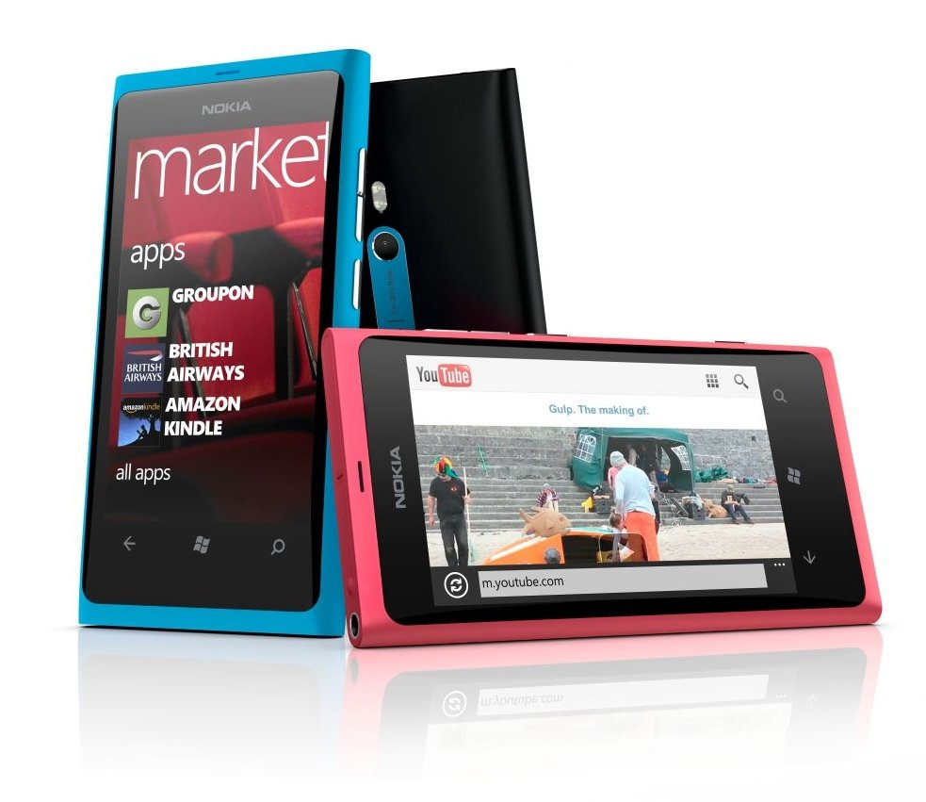

Notes:
Let’s say you’re a company and you’re developing a new app – say, a news reader, and you want to maximize the numbers of potential users you can have.
Chances are that, to truly maximize that number, you’ll have to cover a wide variety of devices.
For instance, in the context of work, and according to Forrester research , there’s an average of 3.2 devices for each person at the enterprise – out of these 3, only 1 will usually be a company device
60% of those users will opt for mobile costumer service applications as a first option
By 2017 mobile users will be provided personalized data streams to more than 100 apps and service, every day
This means that when you develop a new piece of software you’ll be constantly challenged with making it work not on a specific platform as it used to be in the past, but in a variety of devices. Not even at work, where companies traditionally had some control of what was their employees environment, does that still happen.
This causes some problems into the services and cloud support you originally created because now you don’t have only 1 device accessing your service, but you have multiple ones, plus you have multiple formats to deliver to.

Slide 6

Growing user base
Notes:
Eventually, you get more users, and with those, the need to process their multiple requests

Slide 7
Spikes in demand
Notes:
You get spike in demands, for instance in Christmas, or easter, or even lower demand in the summer.

Slide 8
Potential Entrants
Suppliers
Industry Rivalry
Buyers
Substitutes
Time to market
Notes:
You also start to face some challenges like how to add that new feature fast, or get that new service.

Slide 9
Cloud Computing
Notes:
There’s this “new” thing called cloud computing

Slide 10


Cloud Services Models
Traditional Software
Infrastructure
(as a Service)
Platform
(as a Service)
Software
(as a Service)
Applications
Applications
You manage
Applications
Applications
Data
You manage
Data
Data
Data
Runtime
Runtime
Runtime
Runtime
Managed by vendor
You manage
Middleware
Middleware
Middleware
Middleware
Managed by vendor
O/S
O/S
O/S
O/S
Virtualization
Virtualization
Managed by vendor
Virtualization
Virtualization
Servers
Servers
Servers
Servers
Storage
Storage
Storage
Storage
Networking
Networking
Networking
Networking

Slide 11
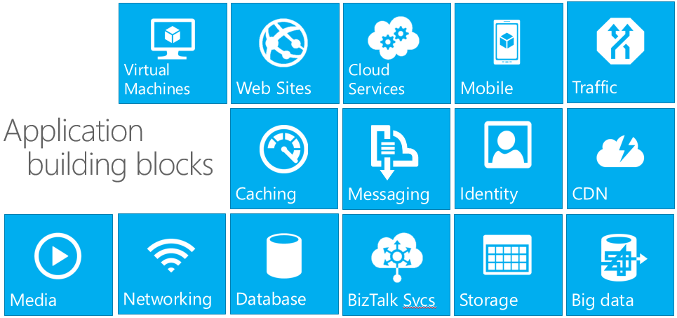
Miriad of Services

Slide 12
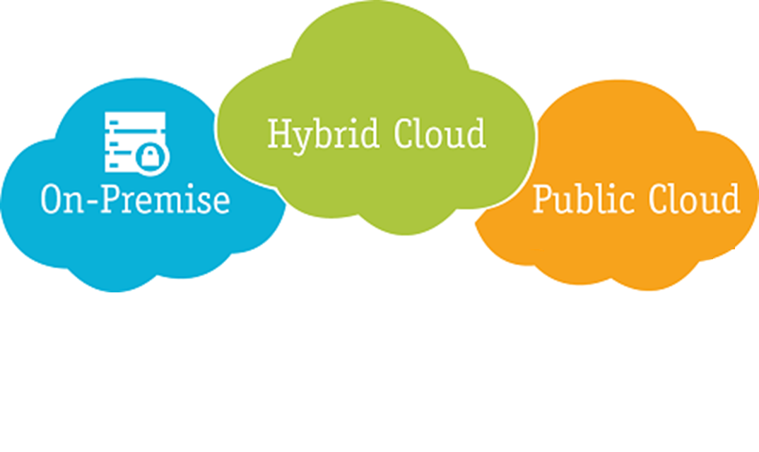

Slide 13
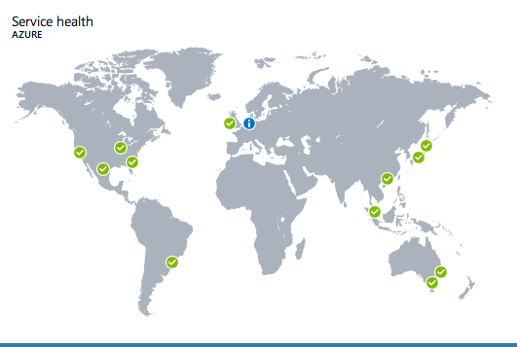
Azure Datacenters
Notes:
We are one of the biggest providers in the cloud computing world – and the only one with presence in china.
We have over 14 datacenter around the world.

Slide 14
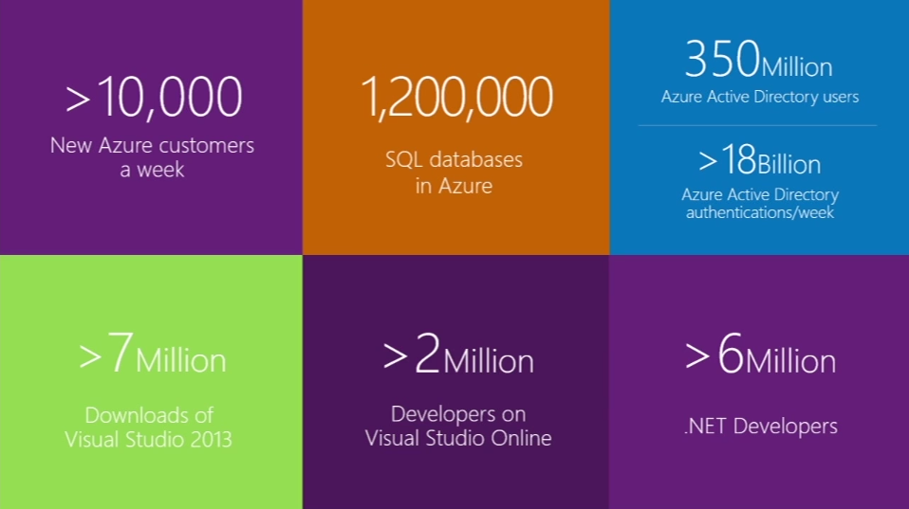

Slide 15

Building a cloud based system
Notes:
What things do you need ? How do you go about choosing a provider ?

Slide 16
Choosing a provider
← Provides the models that I want – IaaS, PaaS or even BaaS
← Provides the infrastructure that you need – Hardware and Software
← Provides the services that you need
← You can use the tools and languages you already know
← Easy to manage and control

Slide 17


Slide 18

@andremrodrigues

Slide 19



Slide 20


+
?

Slide 21
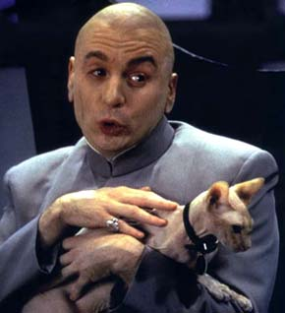
Times have changed

Slide 22


Slide 23



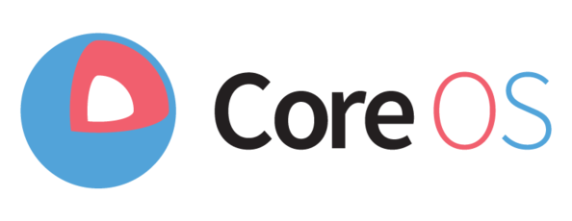
Multiple Operating Systems
Many more … Constantly growing gallery of images to deploy.

Slide 24
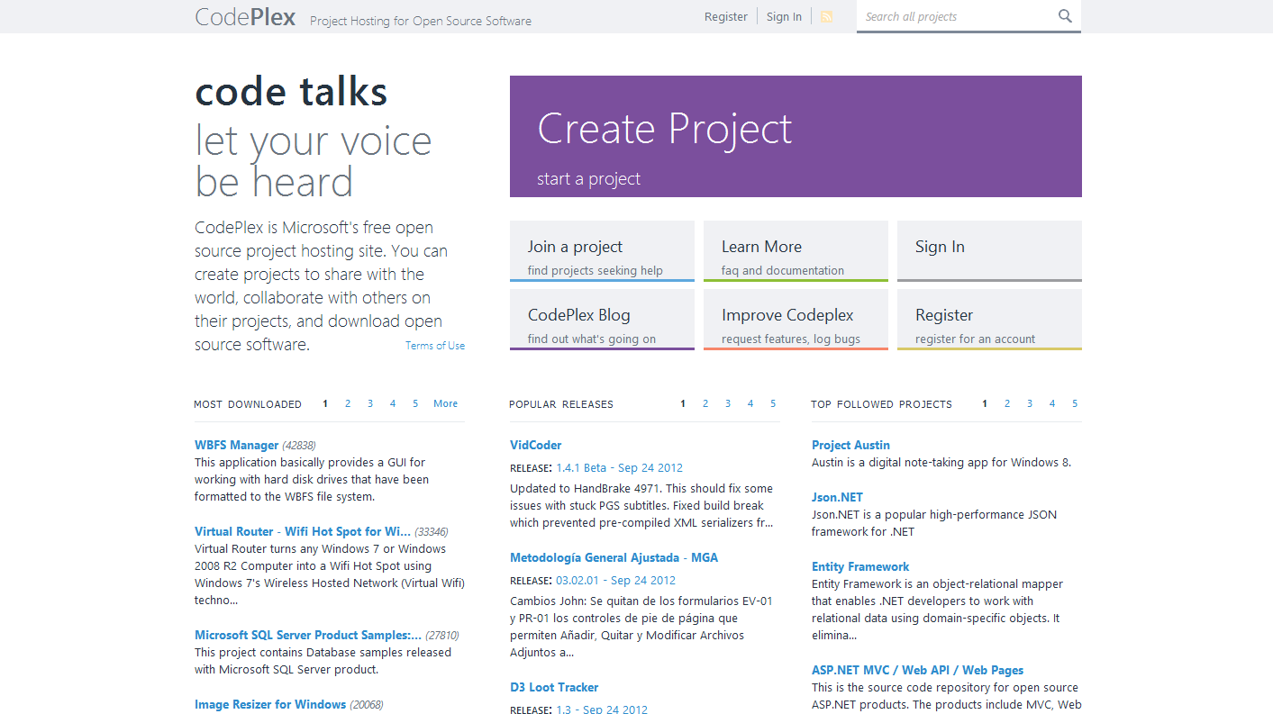
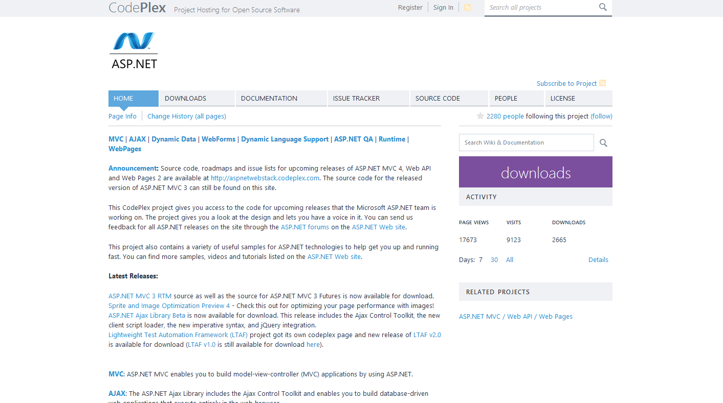
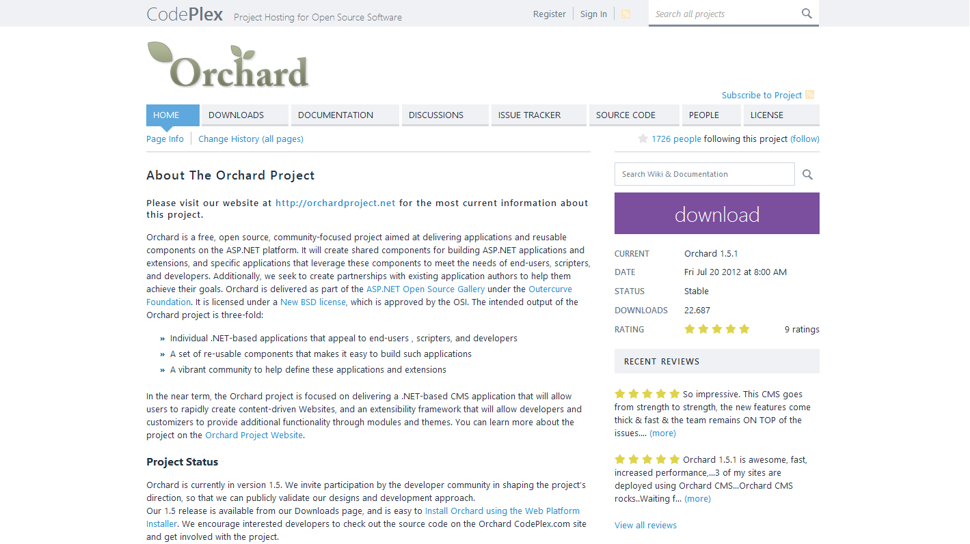
Embracing Open Source
Notes:
Microsoft is actually embracing things like open source where it has even created a foundation, named codeplex, where it makes available source code from some of its products and welcomes new user projects. So everyone can use it free of charges and open up their projects to the world.

Slide 25
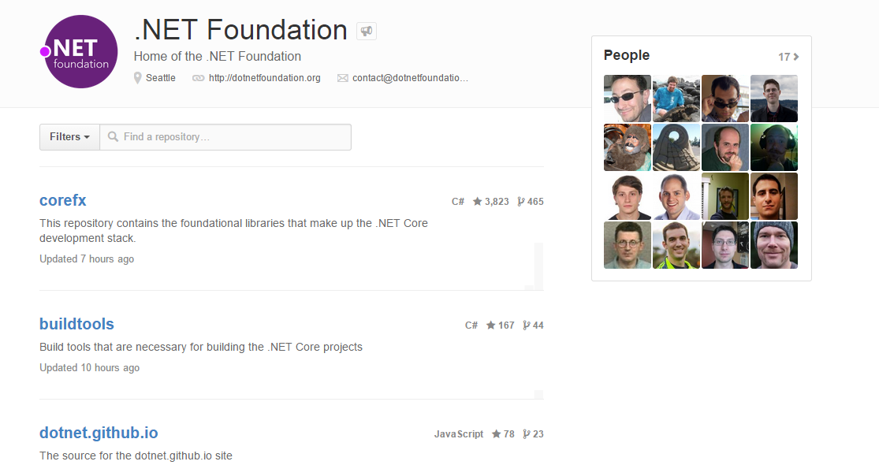
.NET framework
http://channel9.msdn.com/Events/Visual-Studio/Connect-event-2014
Notes:
Earlier 2014 (at the BUILD conference):
ASP.NET
EF
Web API
NuGet
"Roslyn" C# and VB compilers
Now announcing (November 2014)
Open Sourcing:
CLR,
Just-In-Time Compiler (JIT)
Garbage Collector (GC)
Core .NET base class libraries.
Add .NET Core Framework support for Linux and OSX

Slide 26
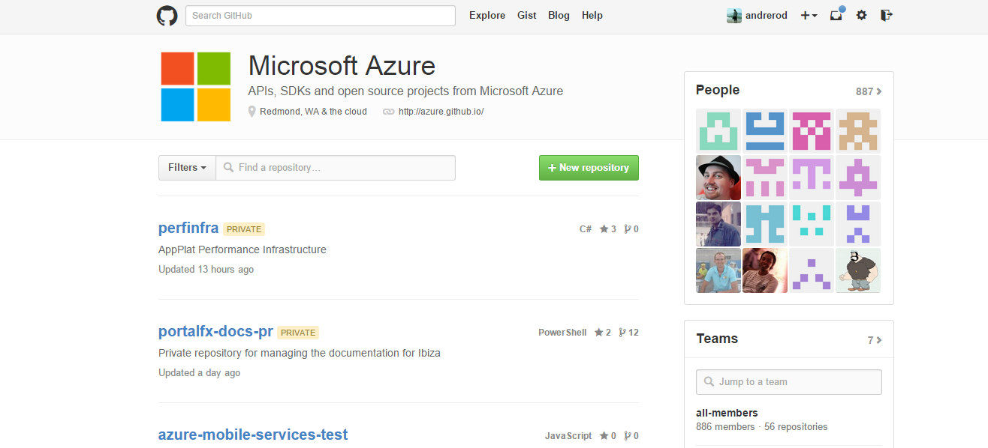
Microsoft Azure SDKs
open source libraries
Apache 2 License
Multiple Languages
Hosted on GitHub
Contributions Welcome
→ http://github.com/azure
Notes:
This is what has happened with the Windows Azure SDKs which are made available in as open source libraries with an apache 2 license for all its languages, hosted on github and which even welcomes contributions.

Slide 27
Variety of languages
← .NET
← Java
← Node.JS
← Python
← Ruby
← PHP

Slide 28
Variety of management platforms
← Rich Web Experience - Portal
← Powershell
← Cross Platform CLI (Bash / CMD)

Slide 29
That’s cool and all, but…
Show us how it works

Slide 30
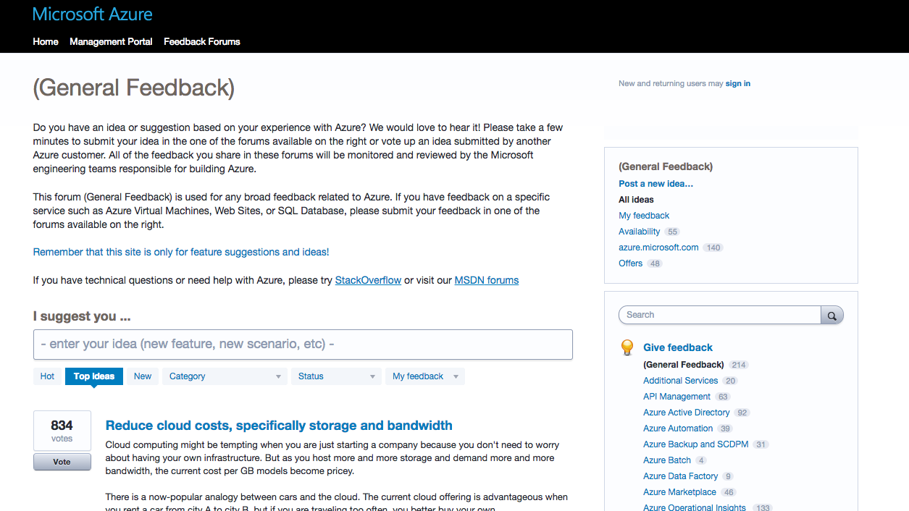
Suggesting features

Slide 31
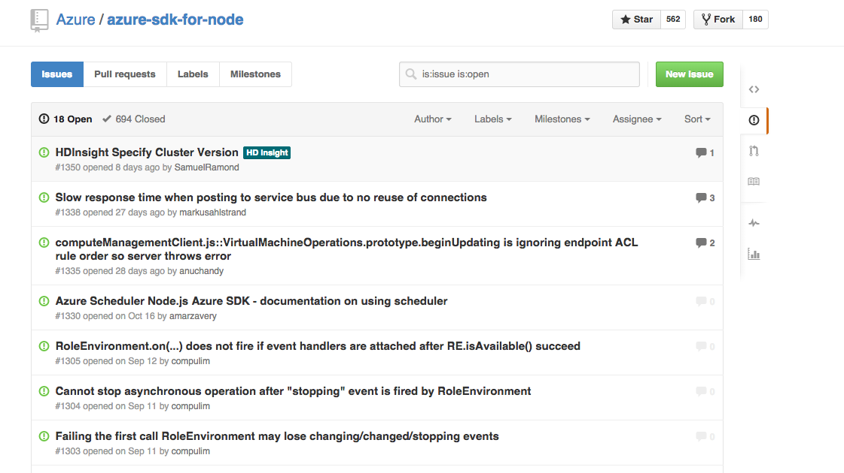
Filing issues

Slide 32
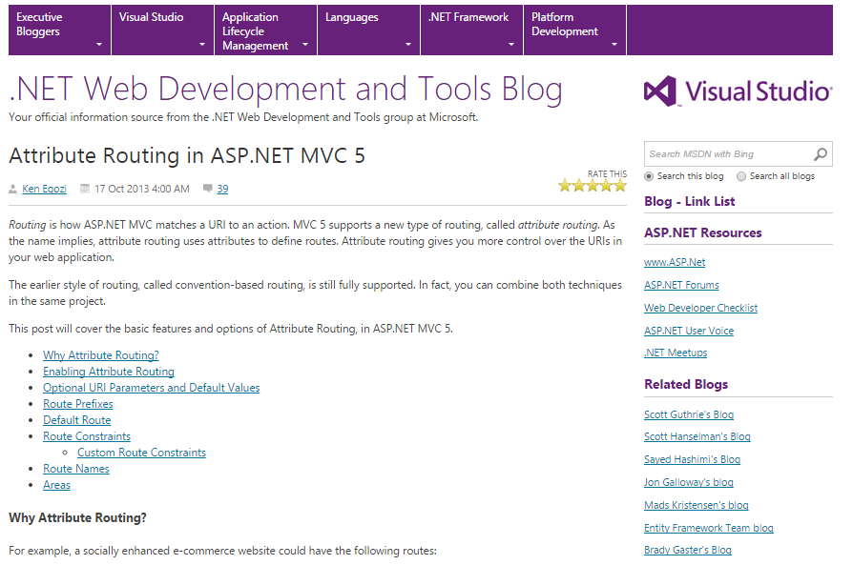
Taking Contributions

Slide 33
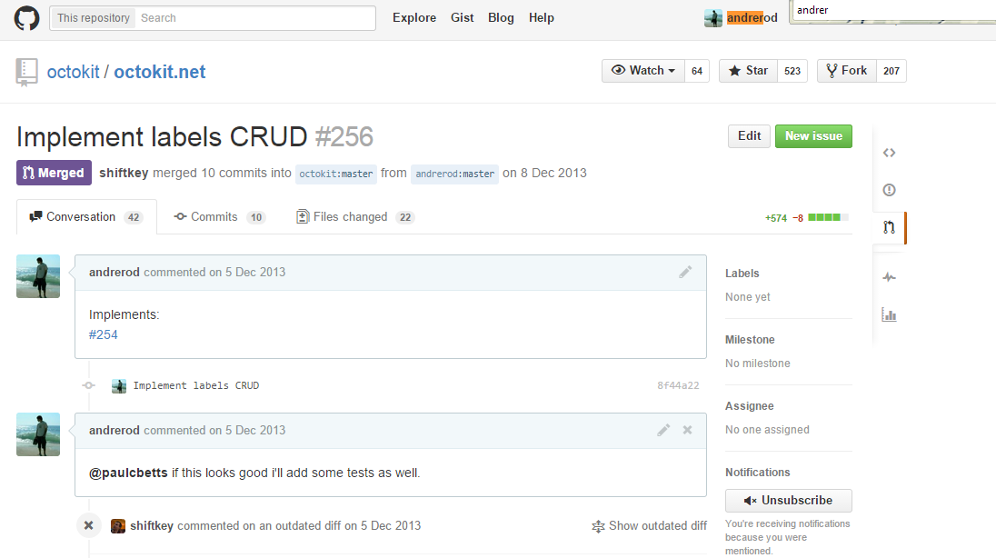

Slide 34
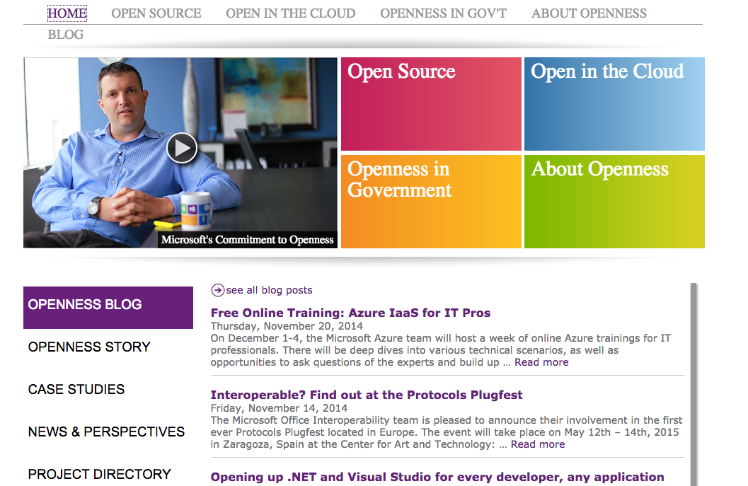
http://www.microsoft.com/en-us/openness/

Slide 35
Key Ideas
← Cloud Computing is the future of computing
← Microsoft wants to be forefront in that future
← Microsoft is becoming a great adopter and driver of open source
← We need you to drive our product forward ☺

Slide 36
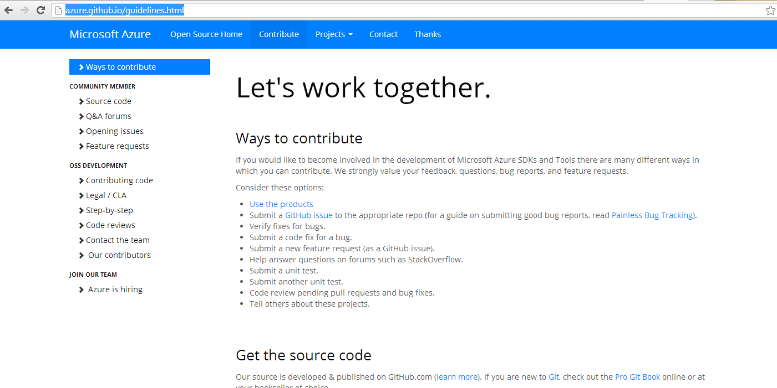
Notes:
As many of you are still in college and graduating soon and probably looking for areas to work on, I hope that the ideas of openness and Mobile first, Cloud first make sense to you not just as a user of them but as a career.

Slide 37
www.azure.com

